Slide 1
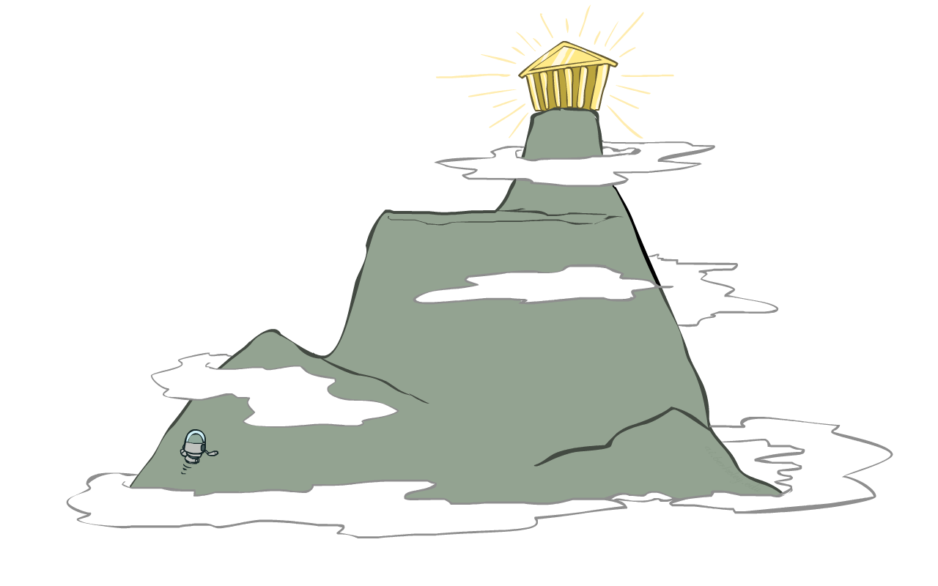
Artificial Intelligence
Local Search & Optimization
CS 444 – Spring 2021
Dr. Kevin Molloy
Department of Computer Science
James Madison University
Much of this lecture is taken from
Dan Klein and Pieter Abbeel AI class at UC Berkeley

Slide 2
Announcements
HW 2 is due tonight
PA 1 is due this Monday, Feb 22
First quiz is released today after class. It is due tomorrow by 5:00 pm tomorrow Friday).

Slide 3
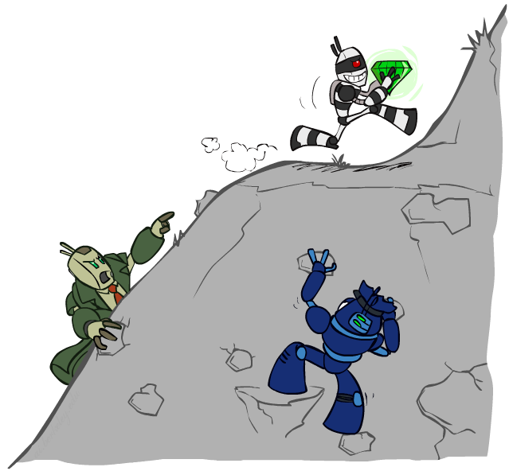
Learning Objectives for Today
Local Search
Hill Climbers
Evolutionary Algorithms
Beam Search
Figure from Berkley AI

Slide 4
Review of Search Problems/Methods so Far
Uninformed and Informed Search
Systematic search
Assume finite state space (not always the case)
Environment may not be fully observable
Figure from Berkley AI

Slide 5
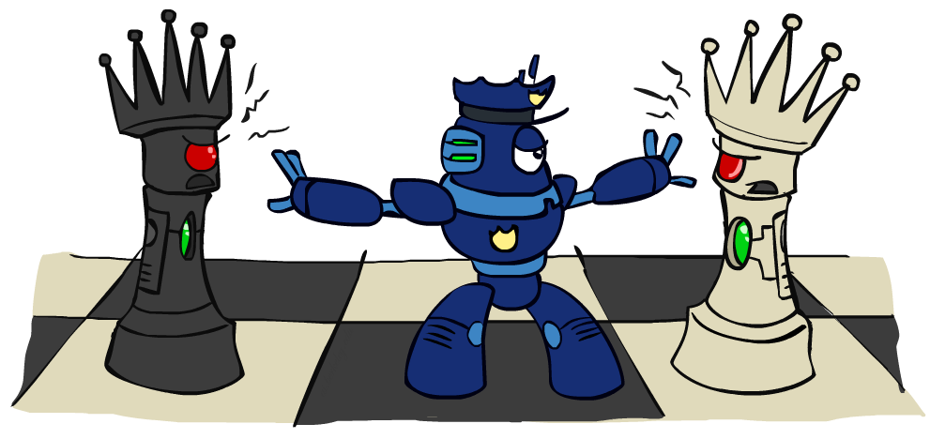
Local Search
Figure from Berkley AI

Slide 6
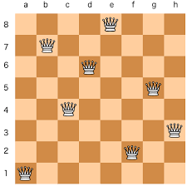
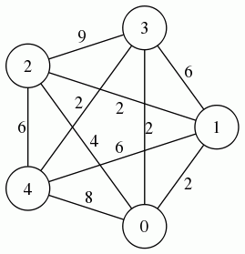
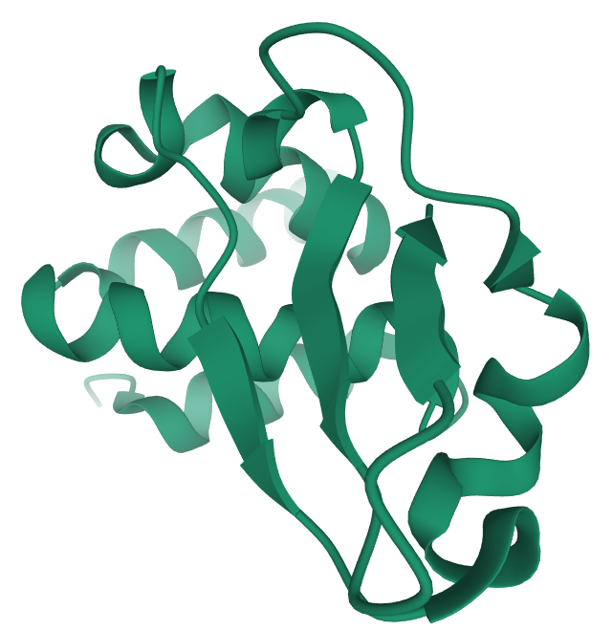
Other Problems to Solve?
Traveling Salemans Problem
Placing N-queens on a chessboard so no queens can "attack" each other
Design the layout of a circuit board
Protein structure prediction
Figure from Berkley AI

Slide 7
Optimization Problems
Key Difference from problems so far?
The goal itself is the solution. No path required
The state space is a set of complete solutions.
Find the optimal configuration.
Key idea: Iterative improvement
Keep a single "current" state, try to improve it. That is, no memory of what has been found so far, hence, sometimes called (memory-less) local search
Iterative refers to iterating between states
Improvement refers to later states improving some objective/goal function or satisfying more
Figure from Berkley AI

Slide 8
Example: Traveling Salesman Problem (TSP)
Start with any complete tour, perform pairwise exchanges
Variants of this approach get within 1% of the optimal solution very quickly (even with thousands of cities)
Figure from Berkley AI
Notes:
A* expanded 8100 ; Path cost = 33
UCS expanded 25263 . Path cost = 33
Greedy expanded 10 . Path cost = 41
[0, 7, 5, 3, 2, 1, 4, 6]
(7, 0, 5, 3, 2, 1, 4, 6)
(6, 4, 1, 2, 3, 5, 0, 7)
(3, 2, 1, 4, 6, 5, 0, 7)
(1, 2, 3, 4, 6, 5, 0, 7)
(5, 6, 4, 3, 2, 1, 0, 7)
(6, 5, 4, 3, 2, 1, 0, 7)
(0, 1, 2, 3, 4, 5, 6, 7)

Slide 9
Example: n-queens
Put n queens on an n x n board with no two queens on the same row, column, or diagonal.
Move a queen to reduce number of conflicts.
Local search techniques can solve this problem almost instantaneously for very large n (n = 1 million) (recall an 8x8 board has 8⁸ states (≈ 17 million states).
Notes:
You know exactly where you came from and how you got there, but you have no idea where you’re going. But, you’ll know it when you see it.

Slide 10
Hill Climbing Algorithm
Simple, general idea:
Start wherever
Repeat: move to the best neighboring state
If no neighbors better than current, quit
What’s bad about this approach?
Complete?
Optimal?
What’s good about it?
Figure from Berkley AI

Slide 11
Hill Climbing
function Hill-Climbing(problem) returns a state (local optimum)
inputs: problem, a problem
local variables: current (a node)
neighbor (a node)
current ← MAKE-NODE(INITIAL-STATE [problem])
loop do
neighbor ← a successor of current
If Value[neighbor] is not better than Value[current]
then return State ← [current]
current ← neighbor
end

Slide 12
Hill Climbing Generating Neighboring States
How is the neighbor of a current state generated?
Varies with approach…
If state space is discrete and neighbor list is finite, all neighbors of a current state can be considered:
Steepest hill climbing: compare best neighbor to current
First-choice hill climbers use the first choice that is improves on current
What if neighbors cannot be enumerated? What if state space is continuous?
Stochastic hill climbing: generate neighbor at random (continuous spaces, perform a small perturbation to generate neighbor)
Gradient-based variants: for continuous state spaces
(Conjugate) Gradient Descent/Ascent
Other numerical optimization algorithms (beyond scope of CS 444)
Figure from Berkley AI

Slide 13
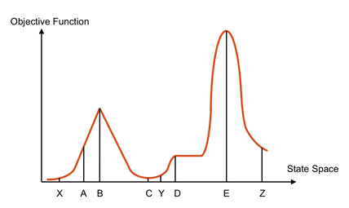
Hill Climbing Quiz
Starting from X, where do you end up ?
Starting from Y, where do you end up ?
Starting from Z, where do you end up ?
Figure from Berkley AI

Slide 14
Challenging Hill Climbing Landscape
Funnell landscape from Ken Dill

Slide 15
Dealing with Local Optima
Randomization:
Random/multi restart allows embarrassing parallelization
Iterated Local Search (ILS)
Memory-less randomized/stochastic search optimization:
Monte Carlo search
Simulated Annealing Monte Carlo
Memory-based randomized search:
Memory via search structure
List: tabu search
Tree-/graph based search
Memory via population
Evolutionary search strategies
Evolutionary Algorithms (Eas)
Genetic Algorithms (GA)
Figure from Berkley AI

Slide 16
Random-Restart Hill Climbers
Idea: Launch multiple hill climbers from different initial states/configurations.
Bonus: Amenable to embarrassing parallelization.
Take-away: It is often better to spend CPU time exploring the space, then carefully optimizing from an initial condition.
Why?
Repeated restarts give a global view of the state space (instead of just the local one provided by each climber).
Drawback? The hill climbers do not talk to one another.
Figure from Berkley AI

Slide 17
Escaping a local maximum/minimum
How to escape from a local minimum?
Make a random move – this is what we call Iterated Local Search (ILS)
Figure from Berkley AI

Slide 18
Local Beam Search
Idea: Don’t keep just a single state, keep k states.
Not the same a k searches in parallel!
Search that finds good states recruits other searches to join them
Generate k starting states at random.
REPEAT
For each state k generate a successor state
Pick the best k states from the set of 2k states (the originals and the "offspring"
Issues/Problems?
Quite often, all k states end up on some local "hill"
Solution: choose k successors randomly (biased towards "good" states". This is call Monte Carlo sampling (robotics/computer vision use this in particle filters).
Figure from Berkley AI

Slide 19
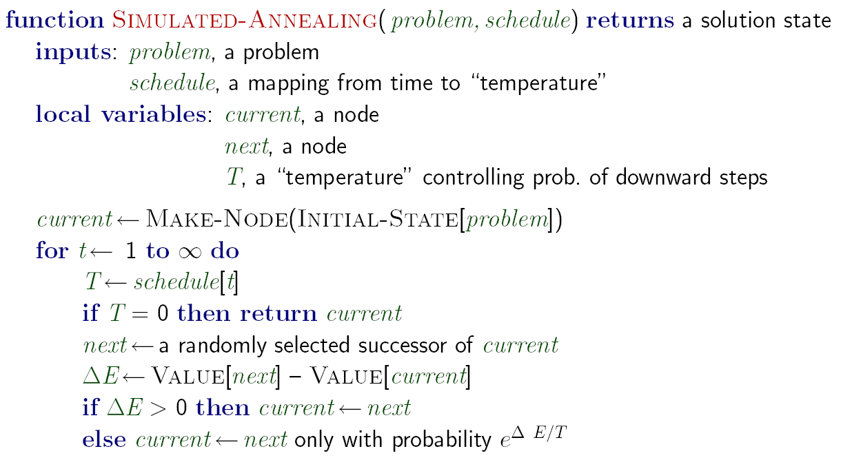

Simulated Annealing
Idea: Escape local maxima by allowing downhill moves
But make them rarer as time goes on
Figure from Berkley AI

Slide 20
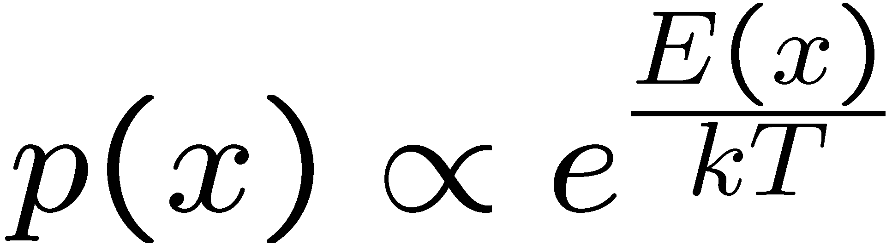
Simulated Annealing
Theoretical guarantee:
Stationary distribution:
If T decreased slowly enough,
will converge to optimal state!
Is this an interesting guarantee?
Sounds like magic, but reality is reality:
The more downhill steps you need to escape a local optimum, the less likely you are to ever make them all in a row
People think hard about ridge operators which let you jump around the space in better ways
Figure from Berkley AI

Slide 21
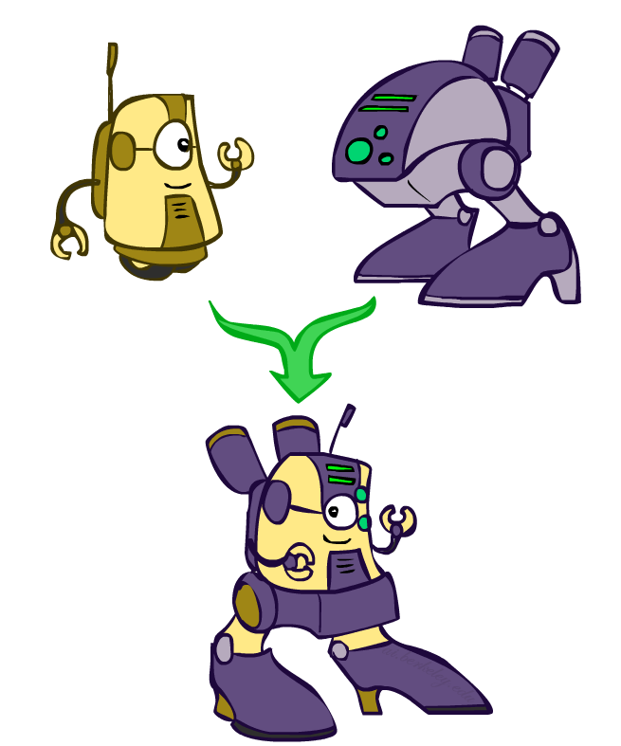
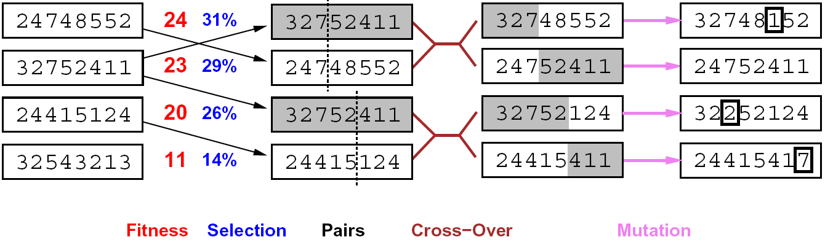
Genetic Algorithms
Genetic algorithms use a natural selection metaphor
Keep best N hypotheses at each step (selection) based on a fitness function
Also have pairwise crossover operators, with optional mutation to give variety
Possibly the most misunderstood, misapplied (and even maligned) technique around
Figure from Berkley AI

